Slide 1
KEERTHY RAAJ SHANMUGAM (200467266)
SUPERMARKET SALES DATASET

Slide 2
Introduction to the Topic
Supermarket Sales Dataset:
Nowadays, Supermarket's growth is skyrocketing in each and every city, although there are many E-Commerce websites to buy products online but still people are preferring to buy products in Supermarket. This is one of a real supermarket company's dataset which is recorded in the year 2019. we can perform plethora of analysis to improve the sale of specific Branch, Product type etc. Moreover, we can predict lots of insights from this dataset.
Reference:
https://www.kaggle.com/aungpyaeap
by Aung Pyae
Studied MSc Data Science at Asia Pacific University (KL, Malaysia)
Mandalay, Mandalay Region, Myanmar (Burma)

Slide 3
Describing the data
Attribute information:
Total no of rows/records/observation : 7000
Total no of columns/features/variable : 14
1)Invoice id: Unique identification number (Primary key)
2)Branch: Branch of supermarket (A, B and C).
3)City: Location of supermarket(Yangon, Naypyidaw and Mandalay).
4)Customer type: Type of customers (Members and Normal)
5)Gender: Gender of customer (male and female).
6)Product line: Product Category (Electronic accessories, Fashion accessories, Food and beverages, Health and beauty, Home and lifestyle, Sports and travel).

Slide 4
7)Unit price: Price($) of each product.
8)Quantity: Number of products.
9)Tax: tax for the products.
10)Total: Total price of the products.
11)Date: Purchase Date(2019).
12)Time: Purchase time (10am to 9pm).
13)Payment: Payment method (Cash, Credit card and E-wallet).
14)Rating: Customer's rating on shopping(1 to 10).

Slide 5
List of Questions
1.Find out the percentage of total sales (income) from every Product line in Supermarket in the year 2019.
2.Find the percentage of Customers who bought products by different Payment Method and Customer type in Supermarket in the year 2019.
3.Find the percentage of Quantity of products sold by different Product line and Gender in Supermarket in the year 2019.

Slide 6
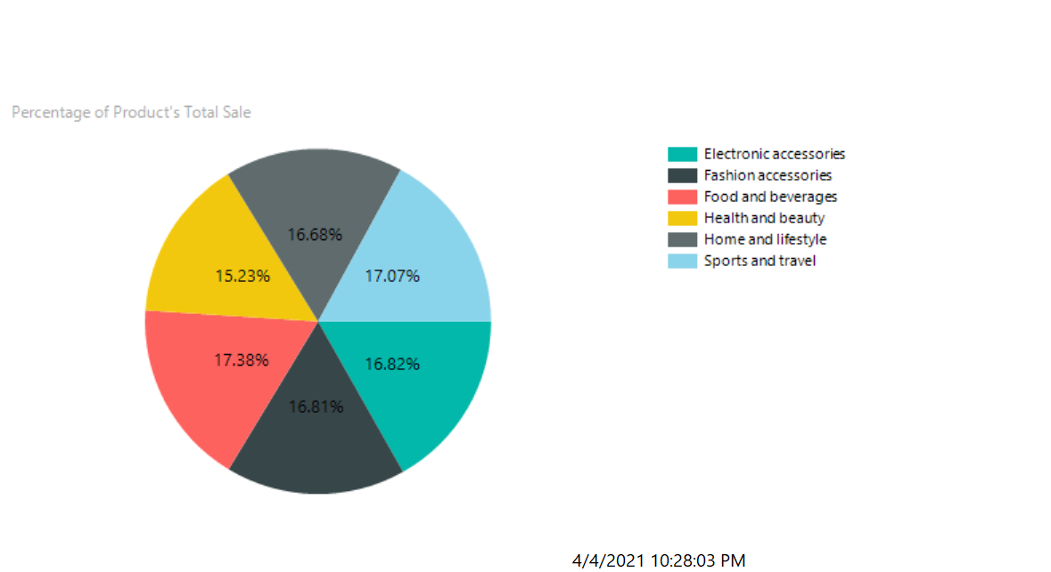
Pie Chart - Report Builder
1.Find out the percentage of total sales (income) from every Product line in Supermarket in the year 2019.

Slide 7
Analysis:
From the above given Pie Chart, we get the percentage of total sales (income) from every Product line and they are as follow, Electronic accessories – 16.82%, Fashion accessories – 16.81%, Food and beverages – 17.38%, Health and beauty – 15.23%, Home and lifestyle – 16.68%, Sports and travel – 17.07%.
Result:
1. The Highest Percentage of Income is from Food and beverages - 17.38.
2. The Lowest Percentage of Income is from Health and beauty - 15.23.

Slide 8
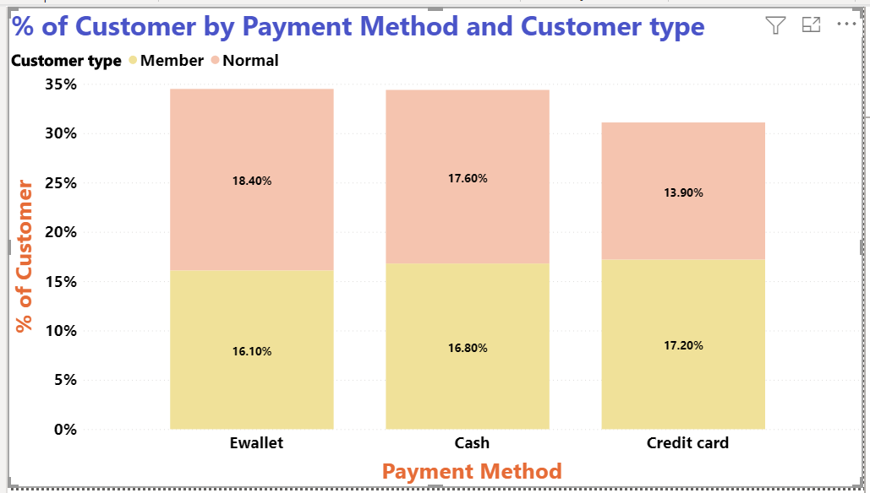
Bar Chart - Power BI
2. Find the percentage of Customers who bought products by different Payment Method and Customer type in Supermarket in the year 2019.

Slide 9
Analysis:
From the above given Bar Chart, we get the percentage of Customers who bought products by different Payment Method and Customer type and they are as follow, Cash (Members – 16.80% and Normal – 17.60% ), Credit card (Members – 17.20% and Normal – 13.90% ) and E-wallet (Members – 16.10% and Normal – 18.40% ).
Result:
1. The highest percentage of Customers use E-wallet for Payment - 34.50.
2. The Lowest percentage of Customers use Credit Card for Payment - 31.10.

Slide 10
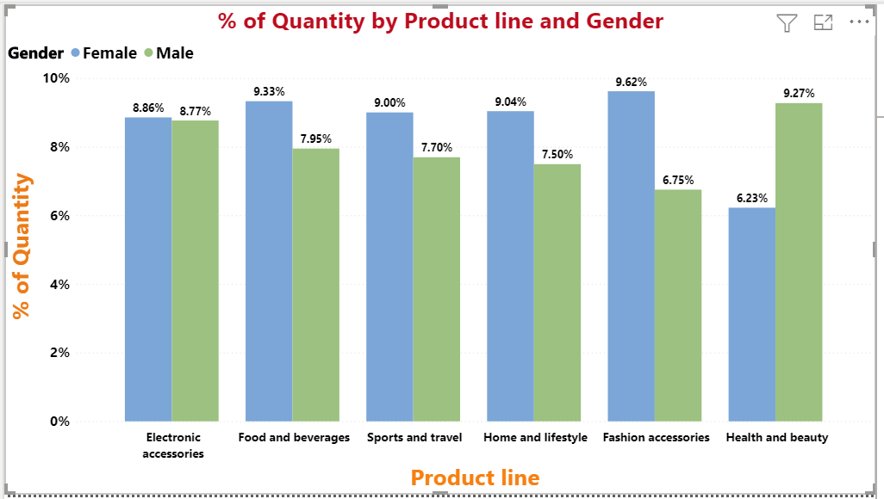
Bar Chart - Power BI
3.Find the percentage of Quantity of products sold by different Product line and Gender in Supermarket in the year 2019.

Slide 11
Analysis:
From the above given Bar Chart, we get the percentage of Quantity of product by different Product line and Gender and they are as follow, Electronic accessories ( Male - 8.77% and Female - 8.86% ), Fashion accessories ( Male - 6.75% and Female - 9.62% ), Food and beverages ( Male - 7.95% and Female - 9.33% ), Health and beauty ( Male - 9.27% and Female - 6.23% ), Home and lifestyle ( Male - 7.50% and Female -9.02% ), Sports and travel ( Male - 7.70% and Female – 9.00% ).
Result:
1) The Highest Percentage of Products was sold under Product line, Electronic accessories - 17.63.
2) The Lowest Percentage of Products was sold under Product line, Health and beauty – 15.50.

Slide 12
Conclusion
From this Supermarket Sales Dataset, we can predict lots of insights which will further be used for Increasing the sales and Reducing the Risk.
THANK YOU!

